Slide 1
Photon Mapping with Participating media (Final Presentation)
Computer Graphics (CSE528)
Kai Chen (109920838)
12-05-2014

Slide 2
Papers
Efficient Simulation of Light Transport in Scenes with Participating Media using Photon Maps
Henrik Wann Jensen, Per H.Christensen

Slide 3
Outline
Background
Implementation
Results
Q & A

Slide 4
Background
Photon Mapping(two-pass algorithm)
Building photon maps by photon tracing
Rendering: combine ray-tracing and estimate the radiance based on photon map
Participating Media
Isotropic, anisotropic
Homogeneous, nonhomogeneous

Slide 5
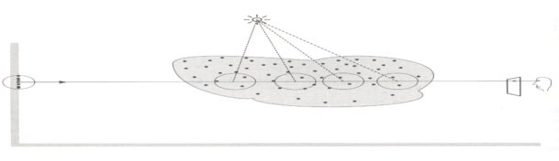
Light Transport in Participating media
p
q
Radiance L changes continuously from L(p,w) to L(q,w)

Slide 6
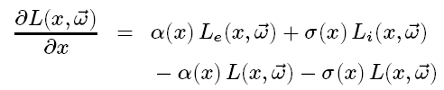
Volume Rendering Equation
emission
in-scattering
absorption
out-scattering
– Absorption coefficient
– Scattering coefficient
– Emitted light
– In-scattered radiance

Slide 7
Outline
Background
Implementation
Results
Q & A

Slide 8
Implementation
Photon maps building using kd tree
Rendering with simple ray-tracer
Volume Photon maps for participating media
Ray march for rendering participating media
Jittering
Photon Visualization

Slide 9
Outline
Background
Implementation
Results
Q & A

Slide 10
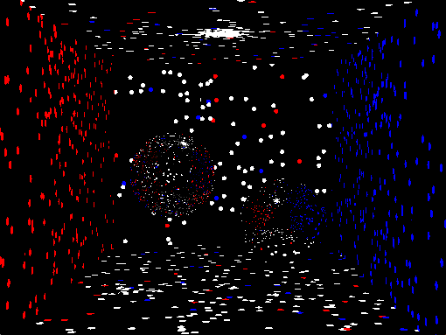
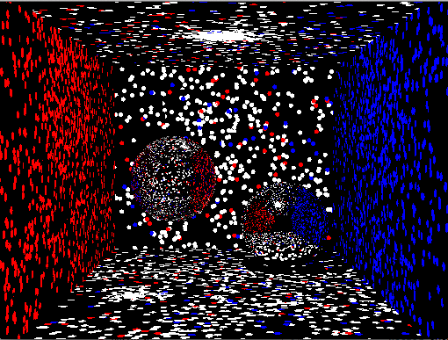
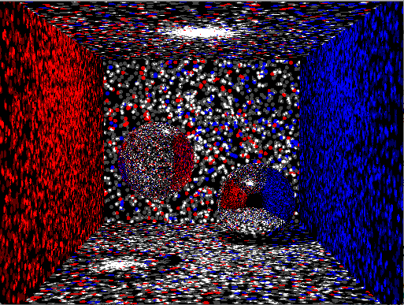
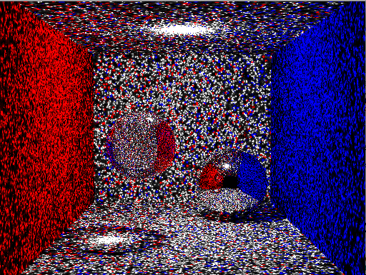
Photon Visualization(1)

Slide 11
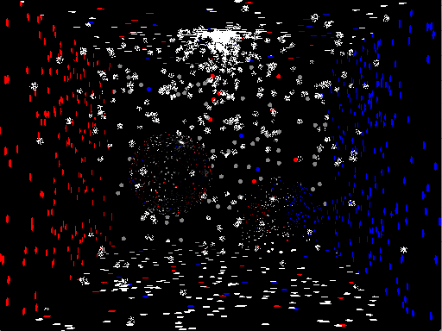
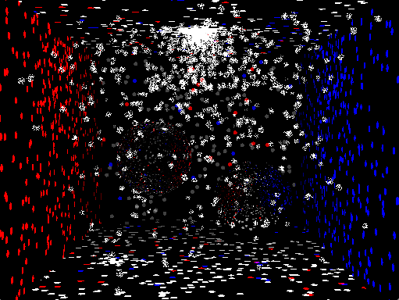
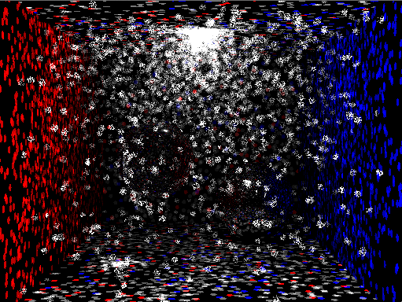
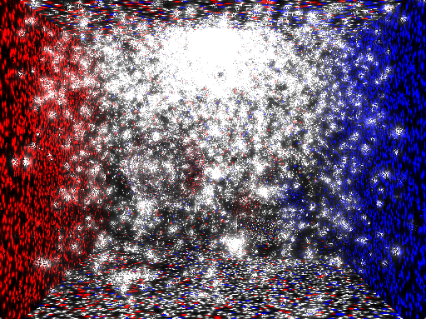
Photon Visualization(2)

Slide 12


Slide 13
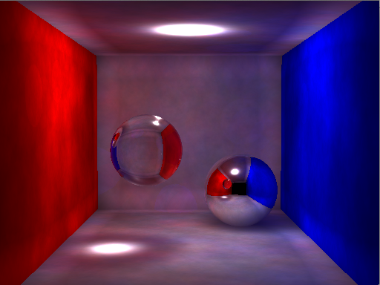
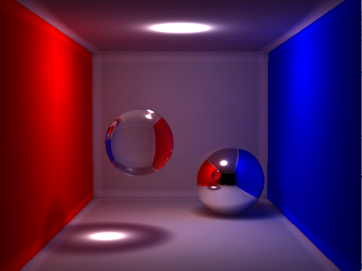
Photon mapping for surface
Cornell Box scene: no participating media
50,000 photons used in the photon map.
Radiance estimate used 500 photons.
Cornell Box scene: no participating media
10 million photons used in the photon map.
Radiance estimate used 20k photons.

Slide 14
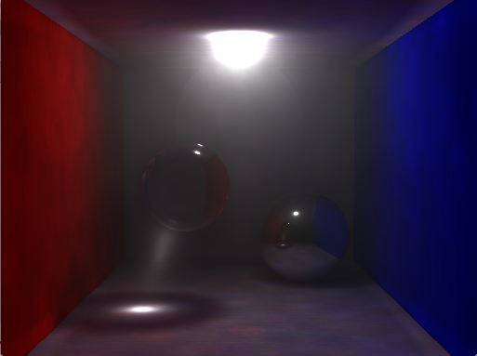
Jittering
Before

Slide 15
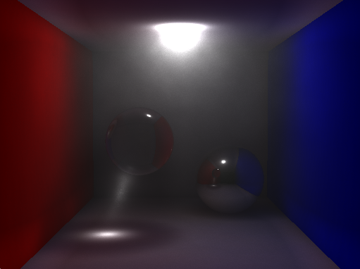
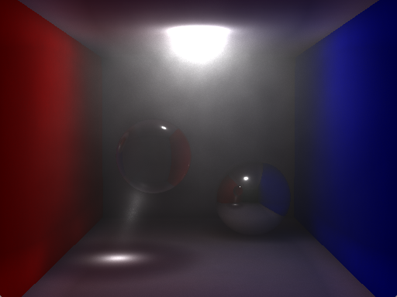
Isotropic & Anisotropic
Cornell Box scene: isotropic, homogeneous
media. 500,000 photons used in the photon
map and 500,000 photons used in volume
photon map. Radiance estimate in the
volume used 200 photons.
Cornell Box scene: anisotropic, homogeneous
Media. It is modeled with Schlick’s scattering
Model. 500,000 photons used in the photon
map and 500,000 photons used in volume
photon map. Radiance estimate in the volume
used 200 photons.

Slide 16
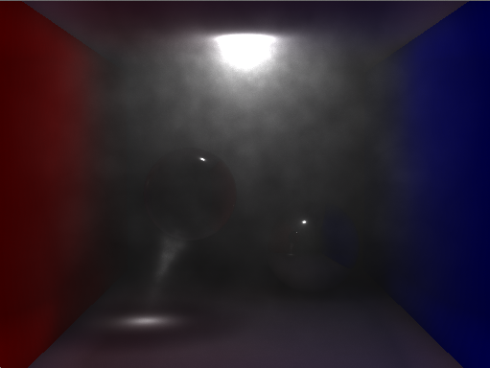
Non-homogeneous
Cornell Box scene: isotropic, nonhomogeneous media. It is modeled using
Perlin noise function. 500,000 photons used in the photon map and 500,000
photons used in volume photon map. Radiance estimate in the volume used 50
photons.

Slide 17
Thank you!
Q & A

